Slide 1
Module 11:Working with PowerShell

Slide 2
Module 11
Working with PowerShell
Setup PowerShell environment for SharePoint
Learn PowerShell statements or cmdlets for SharePoint.
Manage SharePoint using PowerShell

Slide 3
SharePoint Structure
IT
Lists
HR
Libraries
Pages
Project 1
Project 2
Project 3
Policies
Benefits
Lists
Project 4
Project 5
Libraries
Pages
Site Collection
Sub Sites

Slide 4
App Studio
Scripting On-Premises
You must have access to the underlying physical or virtual servers
The script must run on the server itself
You must be logged in with a high level of permissions on the server
You must set the execution policy to allow scripts to run
Your scripts may need to be signed if the system administrator or organizational policy requires it
You need to have access to the SharePoint PowerShell Snap-In and include it in your scripts
You must have a permission level in SharePoint that is high enough to accomplish the tasks you are attempting in your script code (this is also true in SharePoint Online)

Slide 5
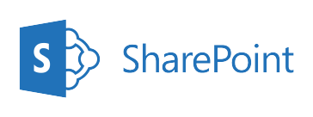
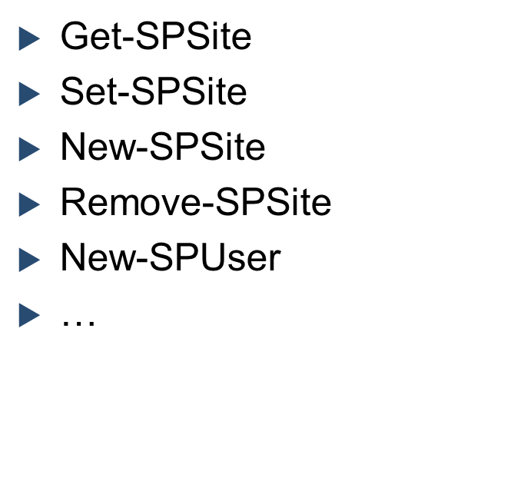
App Studio
SharePoint 2019 On Premises Cmdlets
Microsoft 365 Cmdlets for administrative tasks
Creating sites
Removing sites
Adding users
Creating groups
Etc.
https://learn.microsoft.com/en-us/powershell/module/sharepoint-server/?view=sharepoint-server-ps

Slide 6
App Studio
What do we need?
SharePoint 2019 Management Shell
Microsoft PowerShell cmdlets that you use in SharePoint Server help you complete simple and complex administrative tasks. Command-line Help is available in the SharePoint Management Shell
https://learn.microsoft.com/en-us/powershell/module/sharepoint-server/?view=sharepoint-server-ps

Slide 7
Mange SharePoint site collection
Create SharePoint site collection
STS#3 template is a site with new experience
STS#0 template is a site with classic experience
Get all Web Templates - Get-SPWebTemplate
Create SharePoint Sub Site
Delete SharePoint sites
Restore SharePoint sites
Get All SharePoint Site - Get-SPSite -Identity $site-url
Add-PSSnapin Microsoft.SharePoint.PowerShell -ErrorAction SilentlyContinue
#Configuration Variables
$SiteCollURL = "https://sharepoint/sites/Sales"
$SiteName = "Sales Team Site"
$SiteOwner = “SP\administrator"
$SiteTemplate = "STS#0" #Team Site Template
#Create new Site Collection
New-SPSite -URL $SiteCollURL -OwnerAlias $SiteOwner -Template $SiteTemplate -Name $SiteName

Slide 8
Manage List
Add - PSSnapin Microsoft.SharePoint.PowerShell
function CreateCustomList($siteCollectionUrl, $listName) {
$spWeb = Get - SPWeb - Identity $siteCollectionUrl
$spTemplate = $spWeb.ListTemplates["Custom List"]
$spListCollection = $spWeb.Lists
$spListCollection.Add($listName, $listName, $spTemplate)
$path = $spWeb.url.trim()
$spList = $spWeb.GetList("$path/Lists/$listName")
#adding the field type(Number) to the list
$spFieldType = [Microsoft.SharePoint.SPFieldType]::Number
$spList.Fields.Add("Area", $spFieldType, $false)
#adding the field type(Number) to the list
$spFieldType = [Microsoft.SharePoint.SPFieldType]::Number
$spList.Fields.Add("Population", $spFieldType, $false)
$spList.Update()
}
$siteCollectionUrl = "http://sharepoint/"
$listName = "Continents"
CreateCustomList $siteCollectionUrl $listName

